Slide 1
WorkQuest
Amrutesh Arun, Leonard Floyd, Mekhi Washington, Travis Spicer

Slide 2
Job Description
We were tasked with creating a new job finding app that would give users more information about the job description, application status, and direct messaging with companies.
We based our website off of craigslist jobs which we deemed as a sub-par website. We first wanted to enhance the whole website UI. As well as adding in the application status page which will give live updates on your application status.
This quickly expanded to enhancing many features of the site

Slide 3
Design Goals:
Enhance the site’s usability and functionality
Improve the user experience
Increase the site’s efficiency
Implement an account based system for better security
Provide an improved design to reduce clutter & remove white space

Slide 4
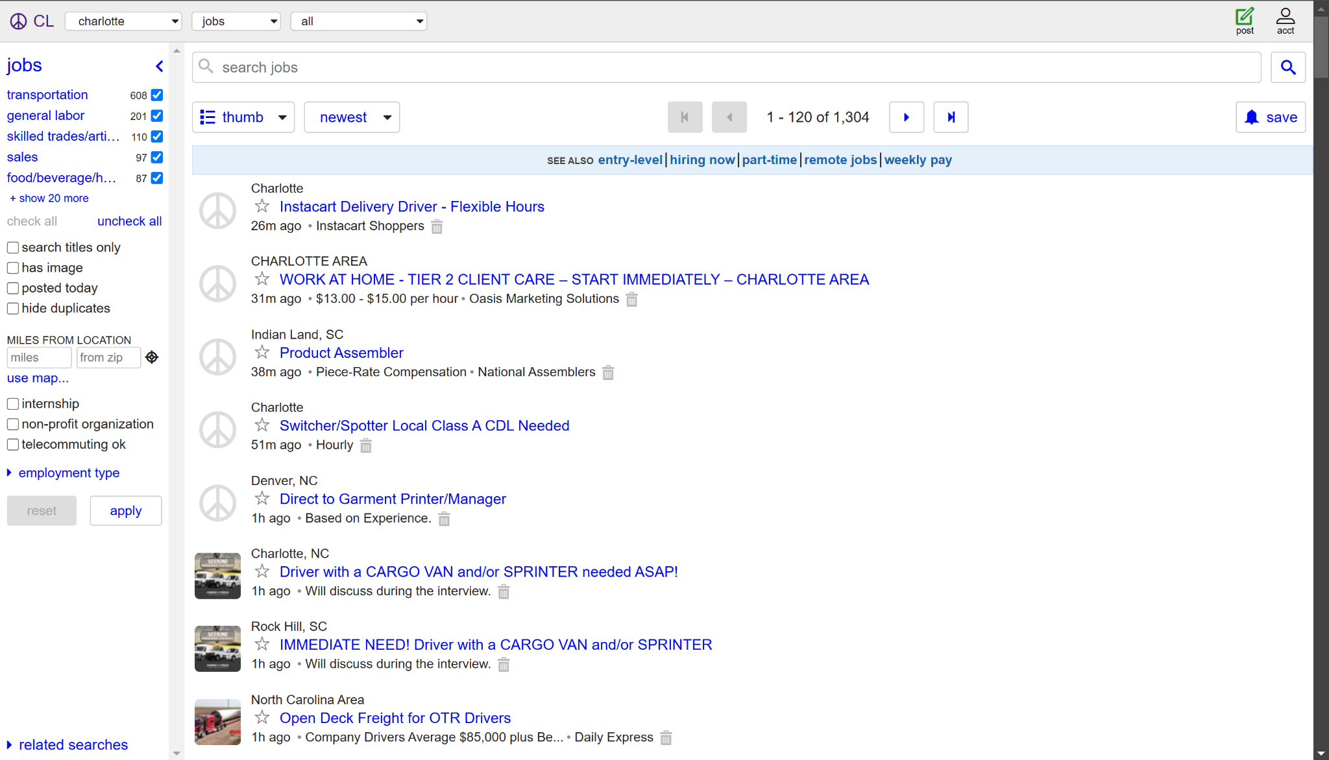
Our starting point
Craigslist Jobs is a simple site that has little visual design or appeal
We wanted to focus on the visual elements & limited functionality of the site to improve it’s readability
We disliked the list orientation and the large amount of white space

Slide 5
Key Enhancements:
Job Application Tracking
Adding User Data to Profile Page
Commenting on a Job Posting
Messaging with Employers
Improved Job Filtering (i.e. payscale, schedule, experience, etc.)

Slide 6
Design Process
In our wireframing phase, we wished to give the UI an overhaul that includes a new filter section, refreshing colors, and a new card based style
We focused on creating a uniform writing style to allow for better readability on the site
We redirected the site’s layout from the list system to a card based layout so that there is less unused white space and to give the site a more appealing look
We had Balance as our main design principle as nearly all of the content on Craigslist Jobs is displayed on the left side of the screen, we wanted for all the content in the page to have use and not have as much wasted space

Slide 7
Wireframing: INSERT WIREFRAMES

Slide 8
Pre-Prototype Usability Testing
We found some users had difficulty understanding the card system without being able to see more of a fleshed out prototype
Some users did not understand that the left side would be comprised of dropdown menus and filtering options to sort through the job listings more efficiently
Most of our users were able to navigate through our wireframes and understand what each element would look like, be used for, and how they would all interact with each other.

Slide 9
Design Changes
We decided to make the dropdown menus & filters more pronounced and to give more of a definitive split between the cards and menus
We added different colored backgrounds to the cards to help distinguish them and color code them based on whatever categories they fit into
We changed some of the spacing between cards and the edges of the site to give better readability

Slide 10
Prototype Usability Testing
We shared our Figma with 8 UNCC students and asked them to complete a few tasks and report on their experience
We asked them to view a job listing, change their location, and to view the profile page information
Here’s some of the feedback we received from the participants:
Messages tab wasn’t functioning properly when clicked
One user got stuck in the applications page
Users suggested the ability to upload their resume to their profile
One user suggested a search function to search through job listings
Professor requested a guest status to view the site without creating an account

Slide 11
Even more Design Changes
We ended up fixing the prototype to respond when the message tab was clicked
We fixed the prototype to allow the user to navigate anywhere from any page
We implemented search functionality to improve efficiency
We added a limited guest mode to access the site without creating an account but the guest users will not be able to use every feature of the site
We added the ability for the user to upload and save their resume under their profile page

Slide 12
Prototype Demonstration
https://www.figma.com/proto/Q8mrgcyloqHv5GoR74obnB/Job-search-portal-Design?node-id=2020-1615&node-type=canvas&t=dy6StVxC9yASmdKr-0&scaling=scale-down&content-scaling=fixed&page-id=54%3A3874&starting-point-node-id=2020%3A1615
Link or open figma in separate tab

Slide 13
Design Challenges EXPAND SLIDE

Slide 14
Development Process
There were difficulties finding API’s for our niches situations so our Development lead ended up creating most of the APIs.
Used Nextjs and Redux in the front end.
Used Tailwind for styling as it’s easier to add responsiveness as well

Slide 15
Final Demo

Slide 16
Conclusion
This app has the potential to have a lot more features we could look into. Some ideas being Resume builder, more interactivity with other users, etc.

Slide 17
Q&A

